Slide 1

Project 3: Web APIs & Classification
Geoffrey Liu

Slide 2
Problem Statement
The project intends to start building a prototype classification model that can assist Reddit to predict which subreddit a post belongs to by using the titles and self text(posts) combined. The aim is to see if the model can potentially speed up the process efficiency for Reddit in detecting if posts in the subreddit should be there or moved elsewhere. Hopefully, the model can eventually be used more broadly for classification to the rest of the subreddits in the future.

Slide 3
Process
Data Collection
Scrape subreddit posts
r/personalfinance
r/StudentLoans
Save the posts to dataframes
Data cleaning
Drop null values in dataframes
Drop duplicate titles in dataframes
Drop duplicate selftext in dataframes
Concatenate dataframes
Apply cleaning function to text
EDA
Use barchart to show top 20 words
Use wordcloud
Modify cleaning function to further remove words
Modeling
Establish baseline accuracy
Model Selection
Evaluation
Conclusion and recommendation

Slide 4

Data Collection
headers = {'User-agent': 'Geoff Inc 8.0'}
r/personalfinance
Personal finance discusses topics on budgeting, saving, getting out of debt, credit cards, investing, and retirement planning
r/StudentLoans
student loans discusses on the student loan debts of individuals and financing issues related to it
-Scraped the posts in JSON (Java script object notation) format with requests library to dataframes
-Retained the name, subreddit, title and self text columns
-Saved the dataframes

Slide 5
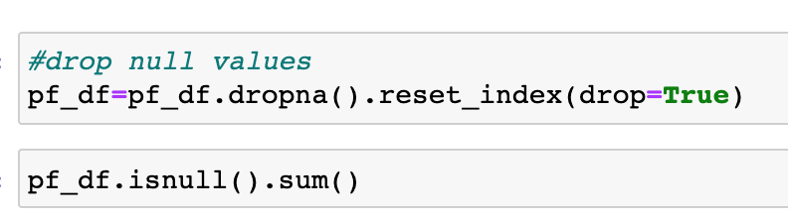

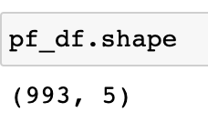
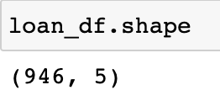
Data Cleaning
Check for null values
Check for duplicates
Concatenate subreddit dataframes
Concatenate title and selftext to all_text
Apply cleaning function for all_text
Includes regex expressions like re.sub('\d','',letters_only) to remove numbers
re.sub('\w*d\w*','',letters_only) to remove words with numbers in them
re.sub("\n"," ",letters_only) to remove new lines
Remove stopwords
Lemmatize
Drop name column from dataframe

Slide 6
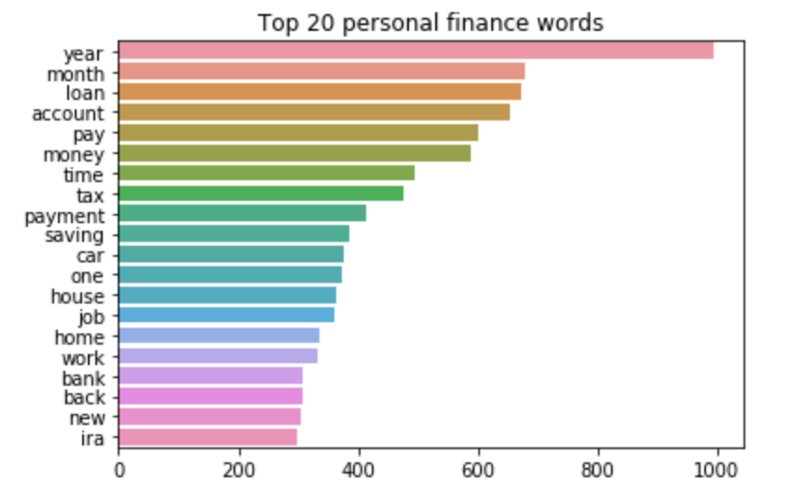
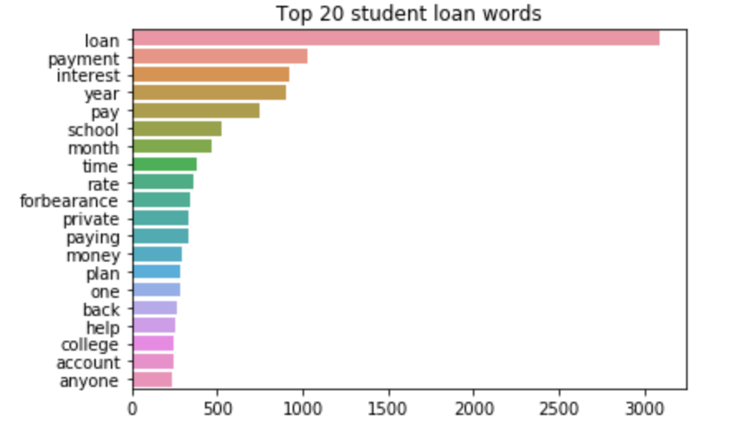
EDA
Created bar charts to show top 20 words for each subreddit
I refined the cleaning function to take out the subreddit’s titles as well as other words like ‘go’, ‘want’ and ‘see’

Slide 7
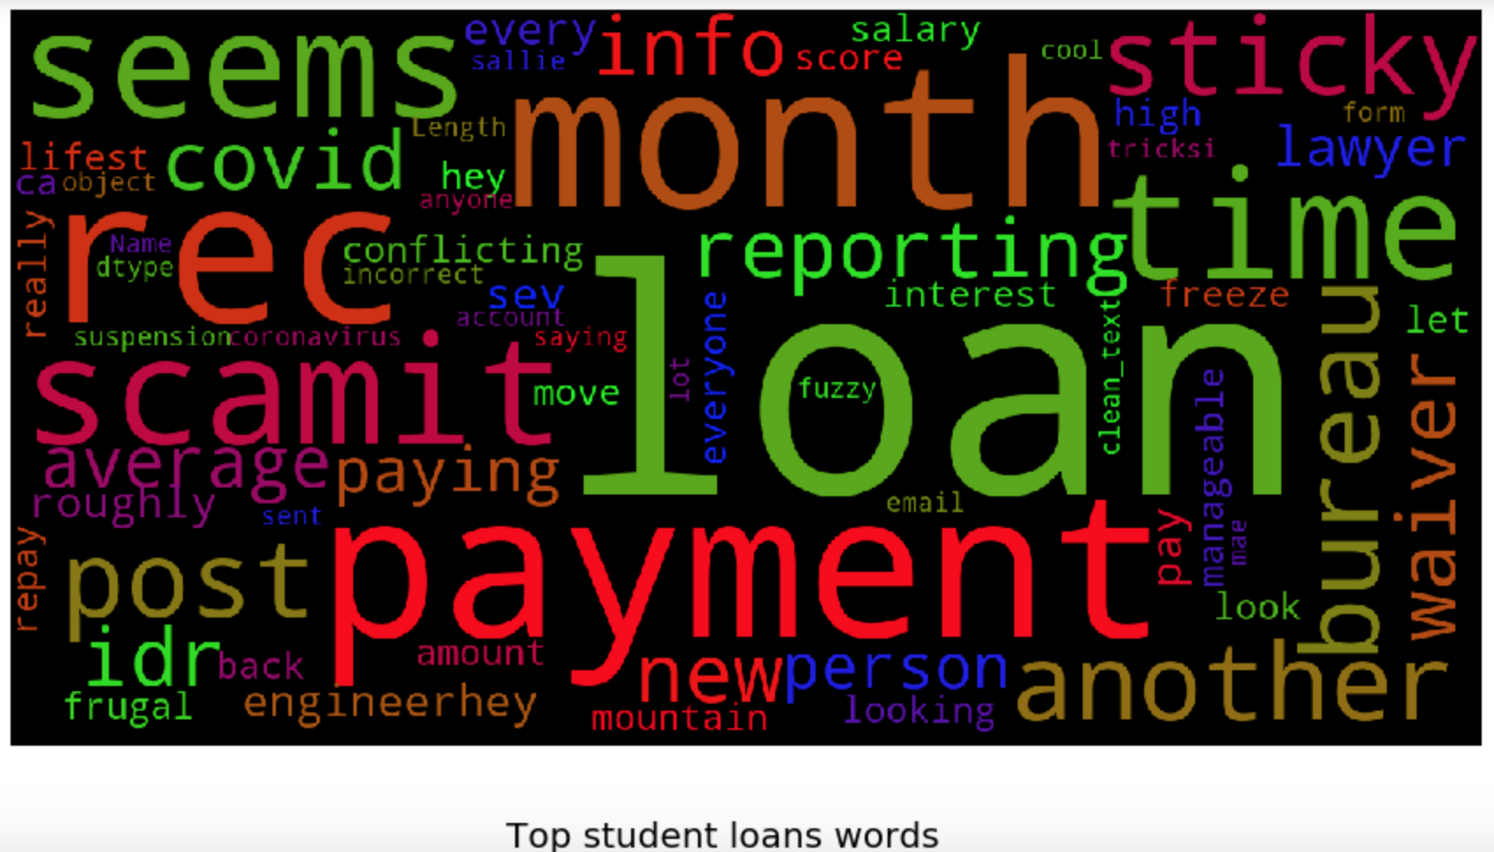
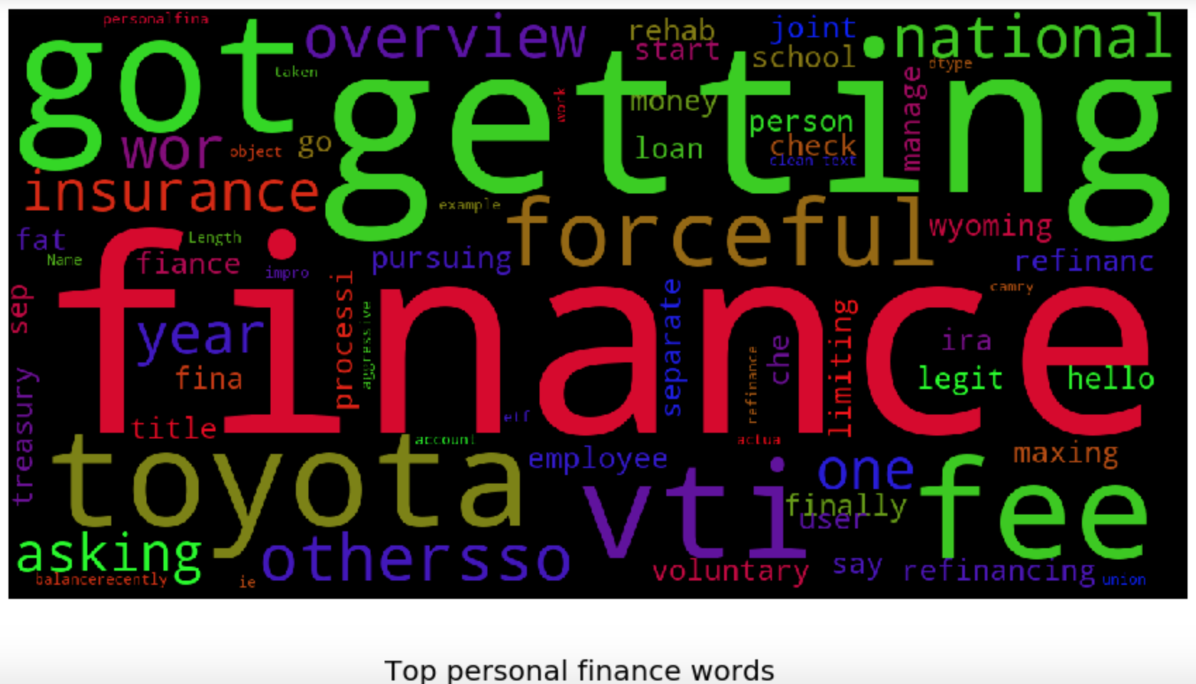
EDA
Word clouds also provide a good visual to see frequently occurring words. The more frequent the word appears the bigger

Slide 8
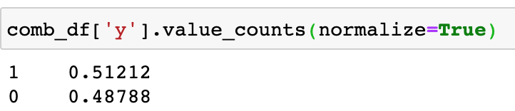
Modeling
Baseline Accuracy
The baseline accuracy for student loans is 0.48788 and 0.51212 for personalfinance. We will proceed to create our X which is the clean_text column of the comb_df consisting of cleaned titles and selftext combined and y target classifications where y is the subreddit category in which personalfinance is 1 and StudentLoans is 0. We will proceed to do a train test split on the X and y variables and begin modeling.

Slide 9
Modeling
Models being used
-GridsearchCV logistic regression count vectorizer
-GridsearchCV logistic regression TFIDF vectorizer
-Gridsearch CV multinomial bayes count vectorizer
-Gridsearch CV multinomial bayes TFIDF vectorizer

Slide 10
Modeling
-GridsearchCV logistic regression count vectorizer
Best params: {'cvec__max_df': 0.75, 'cvec__max_features': 10000, 'cvec__ngram_range': (1, 2), 'lr__multi_class': 'auto', 'lr__random_state': 42, 'lr__solver': 'lbfgs'}
Train score: 1.0
Test score: 0.9031
-GridsearchCV logistic regression TFIDF vectorizer
Best params: {'lr__multi_class': 'auto', 'lr__random_state': 42, 'lr__solver': 'lbfgs', 'tvec__max_df': 0.25, 'tvec__max_features': 6000, 'tvec__ngram_range': (1, 3)}
Train score: 0.9656
Test score: 0.9134

Slide 11
Modeling
-Gridsearch CV multinomial bayes count vectorizer
Best params: {'cvec__max_df': 0.25, 'cvec__max_features': 4000, 'cvec__ngram_range': (1, 3), 'nb__alpha': 0.25}
Train score: 0.9594
Test score: 0.9216
-Gridsearch CV multinomial bayes TFIDF vectorizer
Best params: {'nb__alpha': 0.1, 'tvec__max_df': 0.75, 'tvec__max_features': 4000, 'tvec__ngram_range': (1, 2)}
Train score: 0.9718
Test score: 0.9278

Slide 12
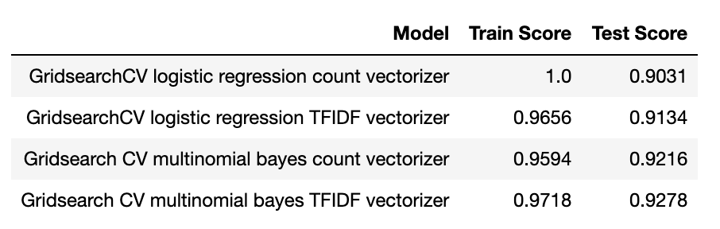
Evaluation
The model that I have chosen is Gridsearch CV multinomial bayes TFIDF vectorizer as it has presented the best score and Niave Bayes modeling is also able to work well with smaller datasets as such in this case where there's 900 plus data points for each subreddit. Also, because the data is not numerical but categorical, Naive Bayes also works well with it.

Slide 13
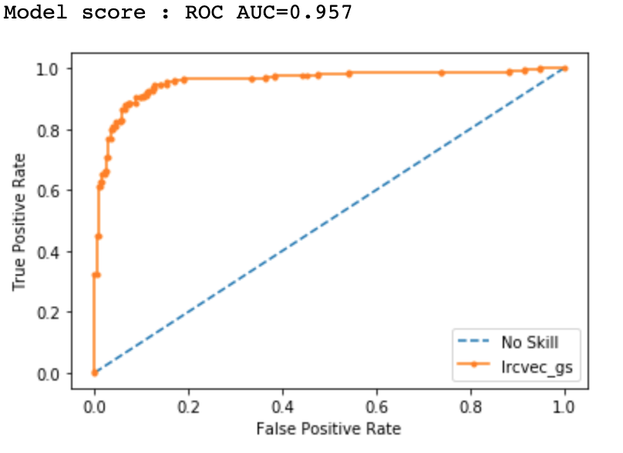
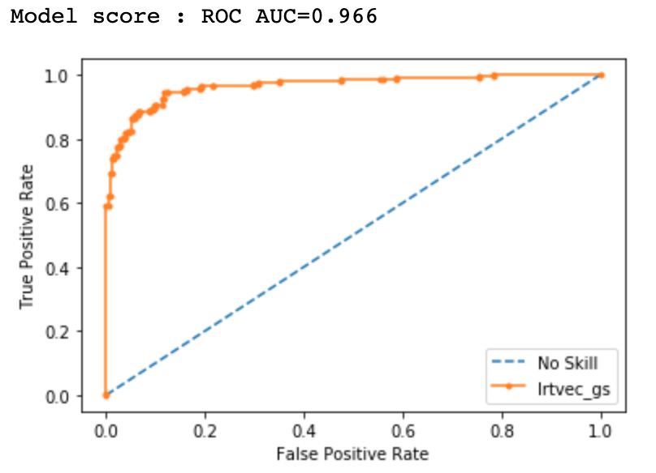
Evaluation

Slide 14

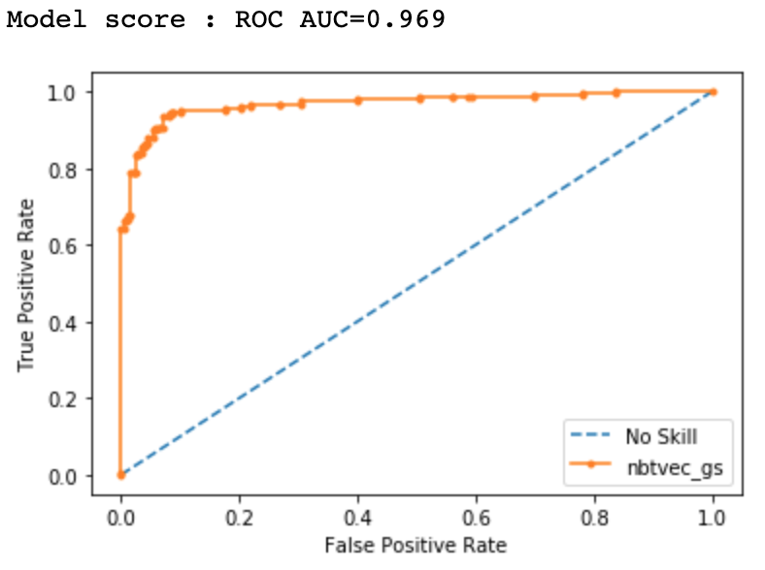
Evaluation
The model also has the highest ROC AUC score of 0.969

Slide 15
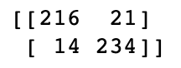
Evaluation
Confusion matrix
I tried changing the threshold to see if the predictions yielded better results but it seems leaving it at 0.5 is the still the best. One thing to note is that if false negative is higher than false positive its seen as more severe than false positives but because our prototype model is trying to detect where posts came from two fairly similar subreddits the false negatives wouldn’t be considered so severe as compared to lets say a classification where class 1 is having breast cancer and class 0 is not having breast cancer
TN FP
FN TP

Slide 16
Evaluation
As the accuracy is fairly high, one reason there could be misclassfication is because some words or words combinations that do not normally appear together in one of the classes shows up in the records

Slide 17
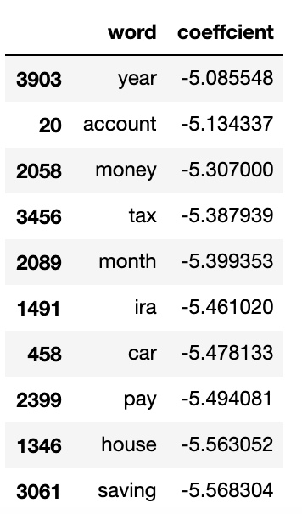
Evaluation
-I noticed that the highest value coefficients such as the ones displayed appear in the class 1 (personal finance) EDA.
-Lowest valued coefficients seem to be from class 0 (Student Loans)
-Was not able to find information on this last night
-But if true, it can serve as a reliable indicator what specific topics people in the subreddit talk about and companies could use this information to advertise their products and services related to the words as shown

Slide 18
Conclusion and Recommendation
Model selected is Gridsearch CV multinomial bayes TFIDF vectorizer as it has presented the best test score at 0.92
Niave Bayes modeling works well with smaller datasets as such in this case where there's 900 plus data points for each subreddit.
Works well with categorical dataset
As the dataset contained about 900 plus posts per subreddit, it may not be representative of each subreddit. More webscraping could be done in the future.
It is possible people's comments could be a good feature to analyze but I am not sure
Due to time restrictions I was not able to repeatedly see words that could be taken out but it could be beneficial to take out words that have similar meaning or synonymous with other words and possibly words that did not get lemmatized.
I should try more models next time like an ensemble model like random forest (Laptop started overheating and process took too long to complete)
Coefficients could help give companies intending to advertise their products and services by showing what people specifically talk about in each subreddit

Slide 19


Thank you!

